Slide 1
WGVBS Chair’s Progress Report
Supreme Audit Institution of Mexico WGVBS Chair
11th KSC-SC meeting
June 13th, 2019, Manila, Philippines
WGVBS | 1

Slide 2
WGVBS Annual Report Membership Status
1 new member:
*India
31 Member SAIs representing:
* 7 Regional Organizations
* 5 INTOSAI official languages

Slide 3
WGVBS Annual Report Forum of SAIs with Jurisdictional Functions
INTOSAI-P 50: Fundamental Principles of jurisdictional activities of SAIs (v. Exposure Draft).– submitted to KSC Chair for last FIPP examination.
Project co-chaired by the SAIs of Chile and France
March, 2019 → Project revised by FIPP
SAIs of Chile and France are considering comments received and will manage the INTOSAI-P 50 translation into the 5 INTOSAI official languages.
New Work Plan 2020-2022 to be presented at XXIII INCOSAI.

Slide 4
WGVBS Annual Report Guideline on Effective Practices of Cooperation between SAIs, the Legislature, the Judiciary and the Executive
Task Team conformation
WGVBS Chair launched a call among members.
Interested SAIs: Ecuador, France, Iraq, Jamaica, and Turkey.

Slide 5
WGVBS Annual Report Guideline on Effective Practices of Cooperation between SAIs, the Legislature, the Judiciary and the Executive
Next steps for final approval as oficial guidance:
Finalize document.
Submit document to FIPP and KSC-SC.
Send document to Community of SAIs and relevant stakeholders for feedback (exposure version → 3-month period).
Update guidance taking into account feedback received.
Translate document into the 5 INTOSAI official languages.

Slide 6
WGVBS Annual Report Guideline on Effective Practices of Cooperation between SAIs, the Legislature, the Judiciary and the Executive
Expected outcome
Guideline foreseen to be approved by INTOSAI GB in its 2020 meeting.
Agreement (Vienna, 2019)
Main text and annex will be split.
Main text will be finalized and the annex will not be presented for approval.

Slide 7
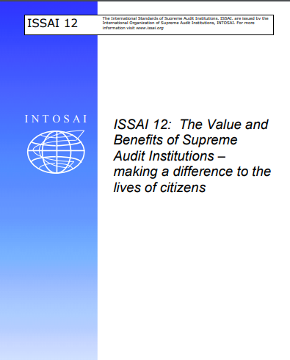
WGVBS Annual Report Implementation of ISSAI 12 Principles
Project led by the SAIs of Namibia, South Africa and Mexico
Gathering of good practices from the INTOSAI Community.
Mapping of existing INTOSAI projects related to value and benefits principles.
Final version expected to be ready by the next WGVBS meeting, in 2020.

Slide 8
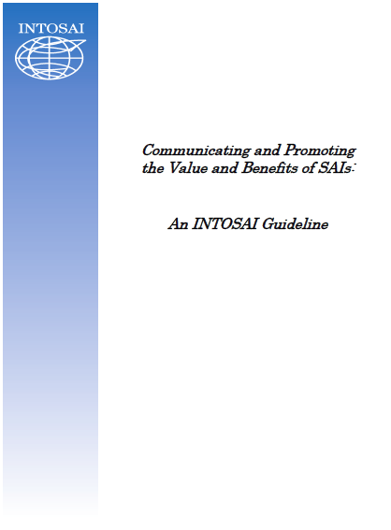
WGVBS Annual Report INTOSAI Guideline Communicating and Promoting the Value and Benefits of SAIs
SAIs of France and Iraq co-lead this Task Team’s work.
Co-leaders help enriching the guideline based on comments by WGVBS members.

Slide 9
WGVBS Annual Report INTOSAI Guideline Communicating and Promoting the Value and Benefits of SAIs
SAI of France
Rewrite document
WGVBS Chair
Sending document to members (Summer 2019)
Examples of good practices
Comments requested to WGVBS and INTOSAI members

Slide 10
WGVBS Annual Report Paper on the SAIs Internal Risk Assessment and the Identification of High Risk Areas / Programs in the Public Sector
Single integrated version updated by the WG Chair, considering comments from members.
Planned to be ready for the XXIII INCOSAI
Dissemination among the INTOSAI Community & stakeholders for comments (3-month period).
Translation into the INTOSAI official languages by SAIs of Austria, France, Kuwait and Mexico.

Slide 11
WGVBS Annual Report Implementation of quality control in the audit process
End of 2018 → questionnaire launched among the INTOSAI Community. (Questions: 20 Response rate: 49/149 member SAIs.)
Responses will help to generate guidance material for the ISSAI 40 principles implementation.
Task Team
Austria
Hungary
Iraq
Kuwait
Peru
Tanzania
Turkey

Slide 12
WGVBS Annual Report Paper on a Risk-management framework for SAIs to incorporate relevant programs related to the Sustainable Development Goals
Updated by the WG Chair, taking into account comments received from members.
Dissemination among the INTOSAI Community & stakeholders for comments (3-month period).
Planned to be ready for the XXIII INCOSAI
Translation into the INTOSAI official languages by SAIs of Austria, France, Kuwait and Mexico.

Slide 13
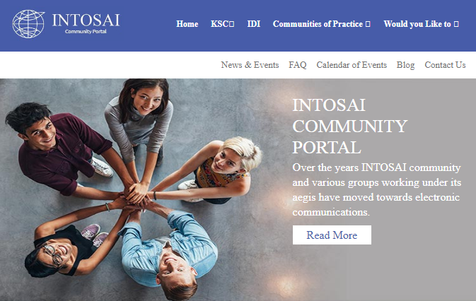
WGVBS Annual Report Transition from WGVBS website to INTOSAI Community Portal
SAI of India (new WGVBS member) → liaison during transition period.
Coordination with KSC in progress.

Slide 14
WGVBS Annual Report Next meetings
13th meeting in 2020
14th meeting in 2021

Slide 15
SAI of Mexico
mcalderon@asf.gob.mx promero@asf.gob.mx

